Slide 1
Functional Programming
By Jake Tripp

Slide 2
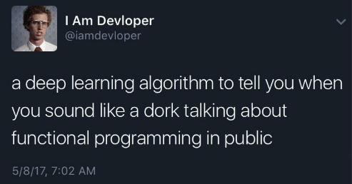

Slide 3
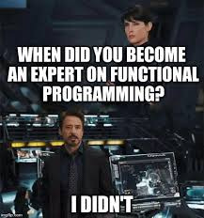
Agenda
Lot of ground to cover
Presentation + Demo will be back and forth
Ask questions during the presentation
Correct me if needed

Slide 4
What is functional programming?
“Functional programming (often abbreviated FP) is the process of building software by composing pure functions, avoiding shared state, mutable data, and side-effects. Functional programming is declarative rather than imperative, and application state flows through pure functions. Contrast with object oriented programming, where application state is usually shared and colocated with methods in objects.”

Slide 5
What is functional programming?
“Functional programming is a programming paradigm, meaning that it is a way of thinking about software construction based on some fundamental, defining principles. Other examples of programming paradigms include object oriented programming and procedural programming.”

Slide 6
What is functional programming?
“Functional code tends to be more concise, more predictable, and easier to test than imperative or object oriented code — but if you’re unfamiliar with it and the common patterns associated with it, functional code can also seem a lot more dense, and the related literature can be impenetrable to newcomers.”

Slide 7
Why you care
Requires less context to understand
Less likely to become a house of cards that everyone is afraid to touch
Reusable
Less error prone
Easier to debug
Easier to test
Ideal for concurrency

Slide 8
Brief History
1930s - lambda calculus developed by Alonzo Church
1937 - Alan Turing proves lambda calculus is Turing complete
Church later develops a weaker system, the simply-typed lambda calculus, which forms the basis for statically-typed functional programming.
1950s - First FP language, LISP, developed at MIT
~1980s-2010 – FP took the backseat as it was less practical with bad hardware while OOP was taking off with languages like C++ and Java
Present – Seeing a resurgence

Slide 9
Core Principles + Code
Something created by math nerds is bound to have a lot of scary words – hang in there!

Slide 10
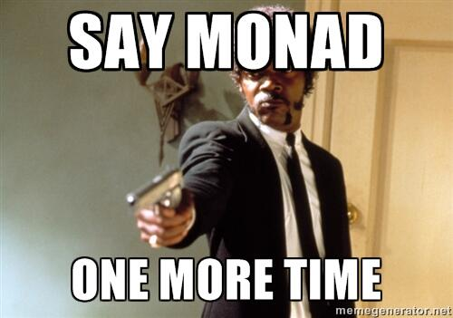
Core Principles + Code
Something created by math nerds is bound to have a lot of scary words – hang in there!

Slide 11
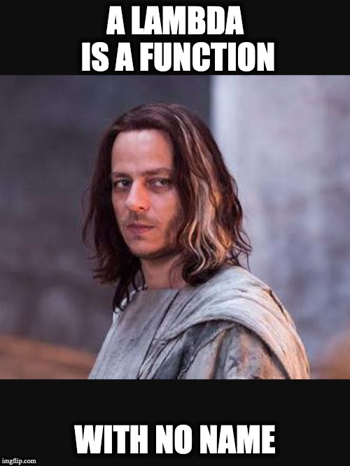
Functions
Can be bound to names
Can be passed as arguments
aka higher order functions
Can be returned by functions
aka higher order functions

Slide 12
Currying
“converting a function that takes multiple arguments into a sequence of functions that each take a single argument”
named after Haskell Curry - can you guess what else was named after him? 😉

Slide 13
Imperative vs Declarative
Imperative – code that shows how you accomplish your intent
C, C++, Java
Feels like a human trying to communicate with a computer
“Heat oven to 375ºF. In small bowl, mix flour, baking soda and salt; set aside…”
Declarative – code that shows what your intent is
SQL, HTML, GraphQL
Feels more like a human trying to communicate with a human
“Hey, can you make me some chocolate chip cookies?”

Slide 14
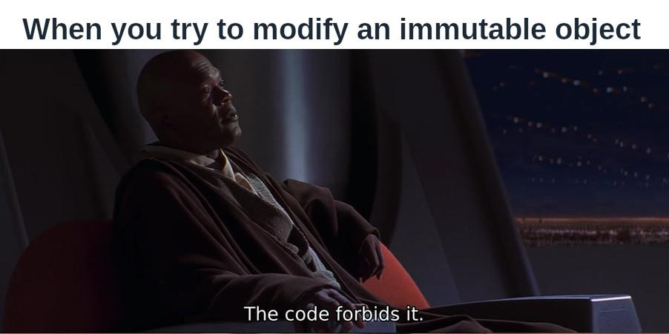
Immutability #1
Don’t modify your data => create new data
Less error prone
Easier to debug
Easier to understand
Easier to test
Better for concurrency and distributed systems

Slide 15
Immutability #2
“The true constant is change. Mutation hides change. Hidden change manifests chaos. Therefore, the wise embrace history.”
“Any experienced programmer will tell you that debugging time outweighs code-writing time by an order of magnitude. And the slight hit on runtime performance is likely outweighed by the state-related bugs your users don’t have to endure.”

Slide 16
Pure Functions
Functions take input and only return output.
Deterministic – the same input will always yield the same output.
No side effects, which include:
Modifying global variables
Modifying input passed by reference
I/O
Triggering any external process
Calling other side effect functions
Always thread safe
Unless you’re an FP zealot, not every function in your code will be pure – and that’s ok!

Slide 17
Referential Transparency
“You can replace a function call with its resulting value without changing the meaning of the program”
Pure, deterministic functions are referentially transparent. This means that you can conceptually (and literally) substitute things in your code.
Lower cognitive load as you can break the problems down
More flexible
Easier to write. If you don’t have a part working yet, you can just write in a fake data structure that you can replace in the future with a dynamic, pure function.
“In math, all functions are referentially transparent”

Slide 18
Minimize State
Default approach: figure out the absolute minimal representation of the state your application needs and compute everything else you need on-demand.
In every codebase I’ve worked on, the vast majority of bugs live in the state maintenance.
If the performance needs of your app aren’t being met with that approach, cautiously maintain more state.

Slide 19
Conclusion

Slide 20
Benefits
Code is modular
Reusable
Easy to build on
Requires less context to understand a function
Less error prone (state maintenance is where most bugs live)
Easy to test
No need for mocks, which are time consuming to set up, brittle, etc.
Easy to debug
Bugs don’t spread, they’re quarantined and easier to identify
Better for concurrency

Slide 21
FP in the world today
Web development with JavaScript, React & Redux
Mobile development with Swift
Backend with Haskell, Erlang, Scala, Rust, Python
Concurrency & big data

Slide 22
Prediction
“This doesn’t mean we’ll all be using Haskell in five years. More likely we’ll see something like the shift to object-oriented programming of the nineties: Smalltalk was the paradigmatic example of OO, but it was more familiar languages like C++ and Java that brought OO to the mainstream. In the case of FP this probably means languages like Scala, Swift, Kotlin, or Rust, and mainstream languages like JavaScript and Java continuing to adopt more FP features.”
“On StackOverflow 2019 Developer Survey Results — the world’s largest survey for programmers around the world — 4 out of the top 5 programming languages associated with the highest salaries are purely functional ones. These results, compared to … 2018, show a large shift in favor of the functional languages.”

Slide 23
Bottom Line
You don’t need to convert every line of code you’ve ever written to be functional programming
You don’t need to be an FP zealot (though don’t feel shame if you are 😈)
With a little effort, you can reap huge rewards
You can make use of parts of FP and OOP together.
You can even accomplish tenets of OOP through FP
notably, polymorphism through generics (as opposed to inheritance)

Slide 24
Questions

Slide 25
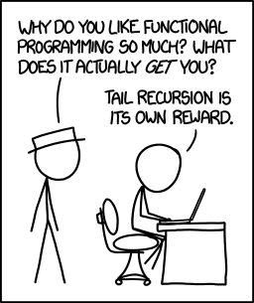
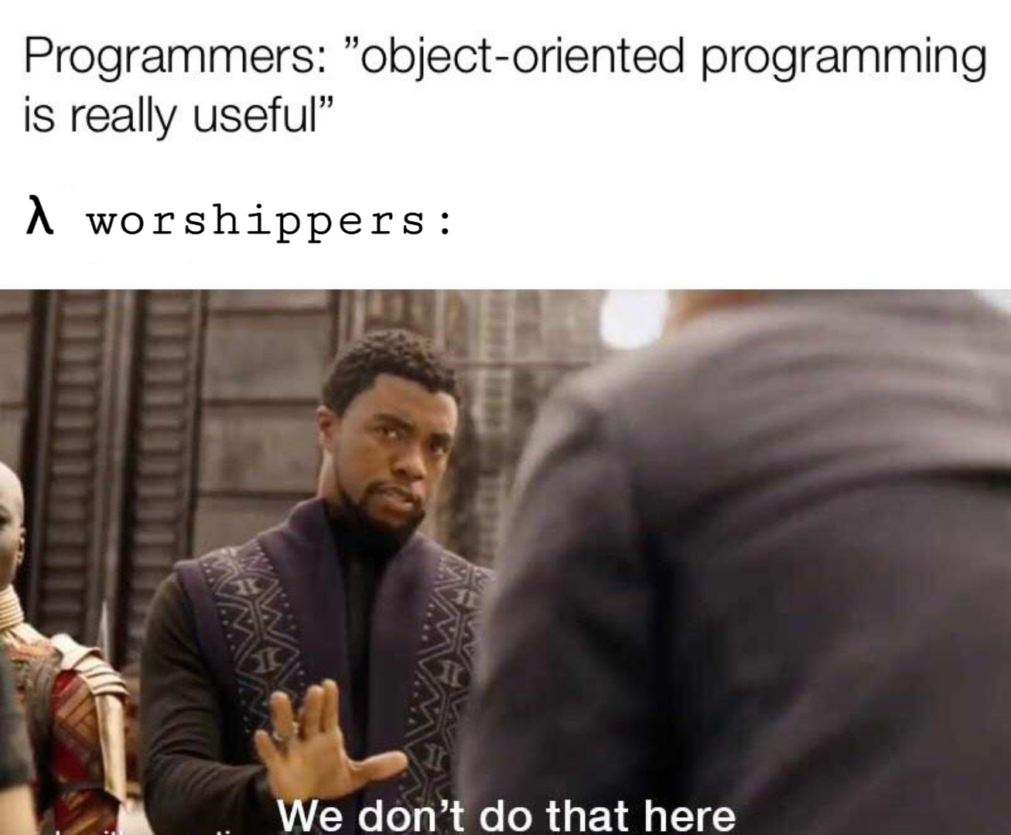
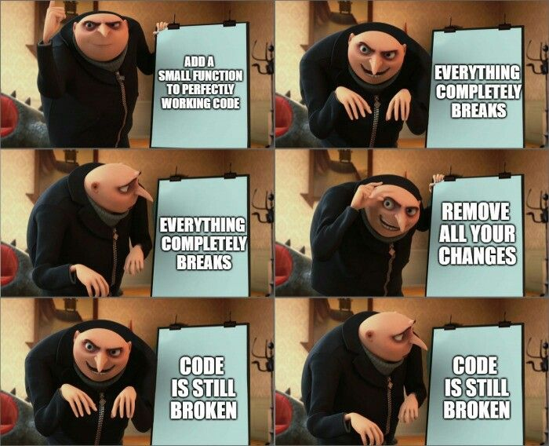
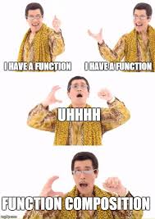
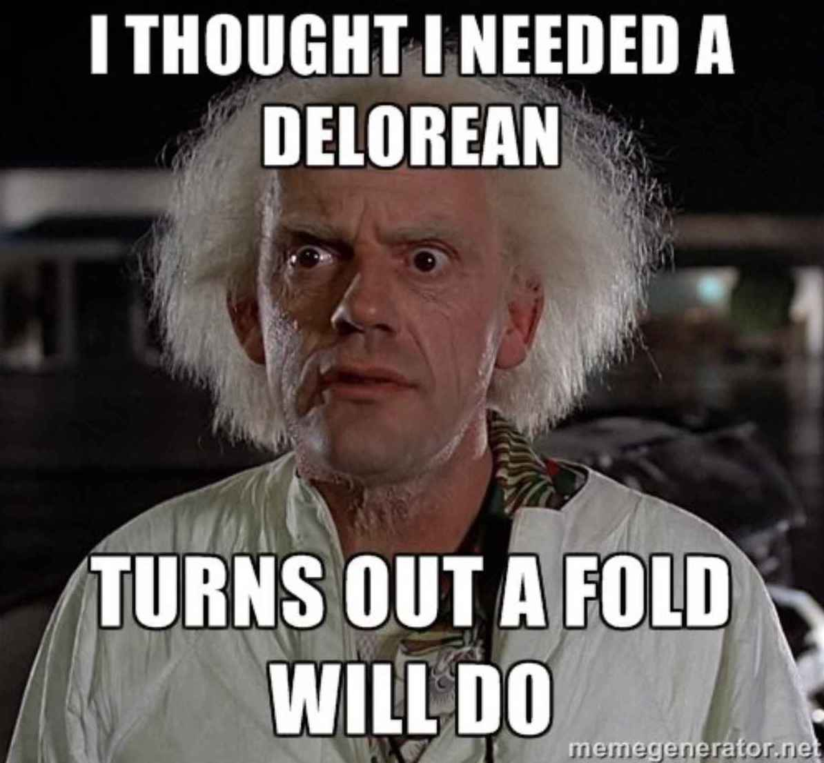

Slide 26
References
Eric Elliot’s medium articles
MPJ’s FunFunFunction YouTube channel, specifically his Functional Programming in JavaScript channel
Declarative vs Imperative
Why FP Matters
FP book by Professor Frisby
FP course by Professor Frisby
What FP is and isn’t
Can your language do this?
Side Effects are the Complexity Iceberg
FP Concepts in JS
Jargon
Minimize State
FP for Big Data

